Slide 1
2 . Poly Phase
&
Magnetic circuits

Slide 2
3-PHASE VOLTAGE
In a 3 phase system, there are three equal voltages or EMFs of the same frequency having a phase difference of 120 degrees. These voltages can be produced by a three-phase AC generator having three identical windings displaced apart from each other by 120 degrees electrical.

Slide 3
PHASE SEQUENCE
Phase rotation, or phase sequence, is the order in which the voltage waveforms of a polyphase AC source reach their respective peaks. For a three-phase system, there are only two possible phase sequences: 1-2-3 and 3-2-1, corresponding to the two possible directions of alternator rotation.

Slide 4
STAR-DELTA connections
In Star connection, the line current is equal to the Phase current, whereas in Delta Connection the line current is equal to root three times of the Phase Current. In Star connection, line voltage is equal to root three times of the Phase Voltage, whereas in Delta Connection line voltage is equal to the Phase voltage.

Slide 5
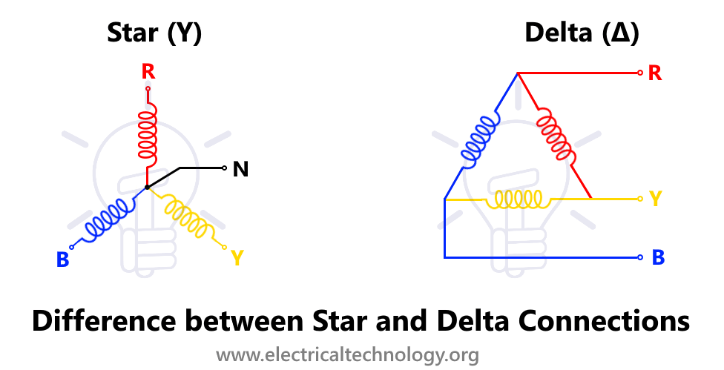
Star – Delta connections

Slide 6
Star – Delta connection derivation
Consider a delta system that’s three corner points are A, B and C as shown in the figure. Electrical resistance of the branch between points A and B, B and C and C and A are R₁, R₂ and R₃ respectively.
The resistance between the points A and B will be,
The resistance between the points A and B will be,R

Slide 7
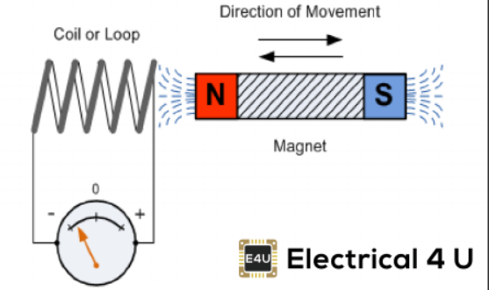
Faraday’s law of Electromagnetic Induction
What is Faraday’s law:-
Faraday’s law of electromagnetic induction (referred to as Faraday’s law) is a basic law of electromagnetism predicting how a magnetic field will interact with an electric circuit to produce an electromotive force (EMF). This phenomenon is known as electromagnetic induction.

Slide 8
Faraday’s law states that a current will be induced in a conductor which is exposed to a changing magnetic field. Lenz’s law of electromagnetic induction states that the direction of this induced current will be such that the magnetic field created by the induced current opposes the initial changing magnetic field which produced it. The direction of this current flow can be determined using Fleming’s right-hand rule.
Faraday’s law of induction explains the working principle of transformers, motors, generators, and inductors. The law is named after Michael Faraday, who performed an experiment with a magnet and a coil. During Faraday’s experiment, he discovered how EMF is induced in a coil when the flux passing through the coil changes.

Slide 9
Faraday’s first law:-
Any change in the magnetic field of a coil of wire will cause an emf to be induced in the coil. This emf induced is called induced emf and if the conductor circuit is closed, the current will also circulate through the circuit and this current is called induced current.

Slide 10
Faraday’s second law:-
It states that the magnitude of emf induced in the coil is equal to the rate of change of flux that linkages with the coil. The flux linkage of the coil is the product of the number of turns in the coil and flux associated with the coil.

Slide 11

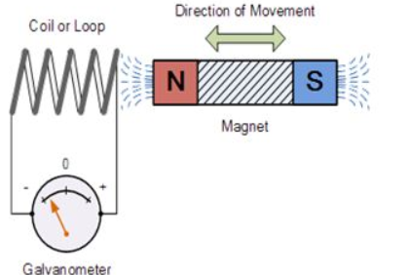
Faraday Law Formula:-
Where:
Flux Φ in Wb = B.A
B = magnetic field strength
A = area of the coil

Slide 12
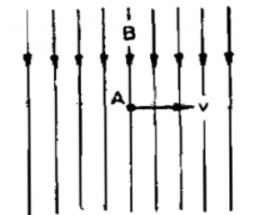
Dynamically induced EMF:-
Dynamically induced emf means an emf induced in a conductor when the conductor moves across a magnetic field. The Figure shows when a conductor “A”with the length “L” moves across a “B” wb/m2.
emf= Blv volt
Flux density with “V” velocity, then the dynamically induced emf is induced in the conductor. This induced emf is utilized in the generator. The quantity of the emf can be calculated using the equation

Slide 13
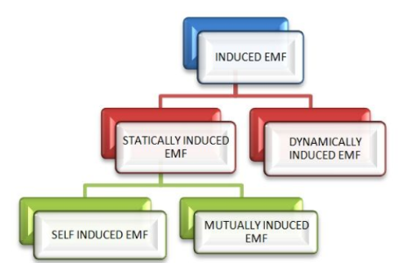
Statically Induced Emf:-
Statically Induced emf is of two types. They are:-
1 .Self induced emf
2. Mutually induced emf.

Slide 14
Self Inductuced emf:-
Self induction is that phenomenon where by a change in the current in a conductor induces an emf in the conductor itself. i.e. when a conductor is given current, flux will be produced, and if the current is changed the flux also changes, as per Faraday's law when there is a change of flux, an emf will be induced. This is called self induction. The induced emf will be always opposite in direction to the applied emf. The opposing emf thus produced is called the counter emf of self induction.

Slide 15
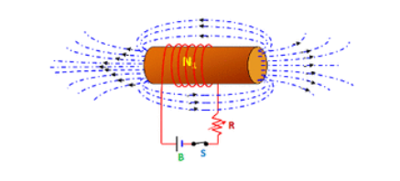
Uses of Self induction
1.In the fluorescent tubes for starting purpose and to reduce the voltage.
2. In regulators, to give reduced voltage to the fans.
3. In lightning arrester.
4. In auto- transformers.
5. In smooth choke which is used in welding plant.

Slide 16
Mutually Induced EMF:-
It is the electromagnetic induction produced by one circuit in the near by second circuits due to the variable flux of the first circuit cutting the conductor of the second circuit, that means when two coils or circuits are kept near to each other and if current is given to one circuit and it is changed, the flux produced due to that current which is linking both the coils or circuits cuts both the coils, an emf will be produced in both the circuits. The production of emf in second coil is due to the variation of current in first coil known as mutual induction.

Slide 17
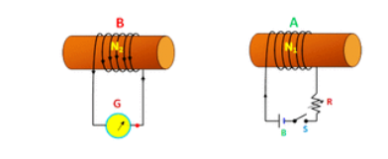
Uses Mutually Induced EMF:-
1. It is used in ignition coil which is used in motor car.
2. It is also used in inductance furnace.
3. It is used for the principle of transformer

Slide 18
Coefficient Of Coupling
The fraction of magnetic flux produced by the current in one coil that links with the other coil is called the coefficient of coupling between the two coils. It is denoted by (k).
Two coils are taken coil A and coil B, when current flows through one coil it produces flux; the whole flux may not link with the other coil coupled, and this is because of leakage flux by a fraction (k) known as Coefficient Of Coupling.

Slide 19
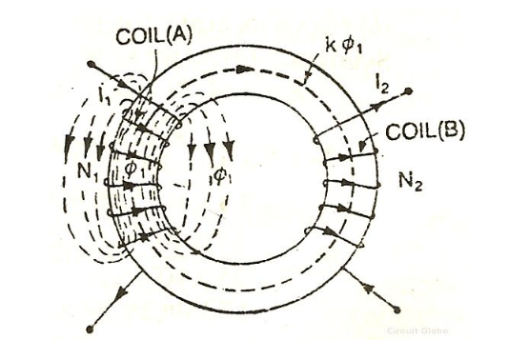
k=1, when the flux produced by one coil, completely links with the other coil and is called magnetically tightly coupled.
k=0, when the flux produced by one coil, does not link at all with the other coil and thus the coils are said to be magnetically isolated.

Slide 20


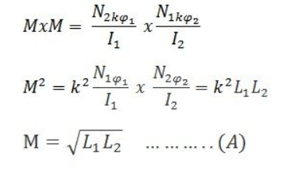
DERIVATION
Consider two magnetic coils A and B. When current I₁ flows through coil A.
Considering coil B in which current I₂ flows
Multiplying equation (1) and (2)
The above equation (A) shows the relationship between mutual inductance and self-inductance between the two coils

Slide 21
Inductances in parallel:-
When inductors are connected in parallel, the total inductance is less than any one of the parallel inductors’ inductances. Again, remember that the definitive measure of inductance is the amount of voltage dropped across an inductor for a given rate of current change through it. Since the current through each parallel inductor will be a fraction of the total current, and the voltage across each parallel inductor will be equal, a change in total current will result in less voltage dropped across the parallel array than for any one of the inductors considered separately. In other words, there will be less voltage dropped across parallel inductors for a given rate of change in current than for any of those inductors considered separately, because total current divides among parallel branches. Less voltage for the same rate of change in current means less inductance.

Slide 22
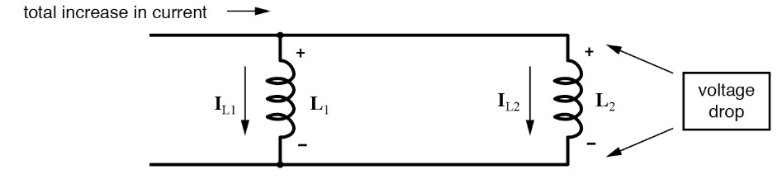
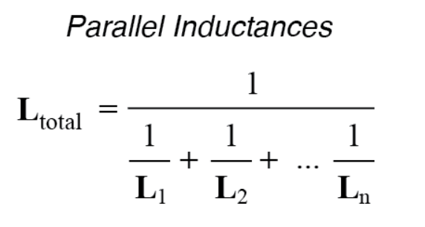
Thus, the total inductance is less than any one of the individual inductors’ inductances. The formula for calculating the parallel total inductance is the same form as for calculating parallel resistances:

Slide 23
Inductances in series:-
When inductors are connected in series, the total inductance is the sum of the individual inductors’ inductances. To understand why this is so, consider the following: the definitive measure of inductance is the amount of voltage dropped across an inductor for a given rate of current change through it. If inductors are connected together in series (thus sharing the same current, and seeing the same rate of change in current), then the total voltage dropped as the result of a change in current will be additive with each inductor, creating a greater total voltage than either of the individual inductors alone. Greater voltage for the same rate of change in current means greater inductance.

Slide 24
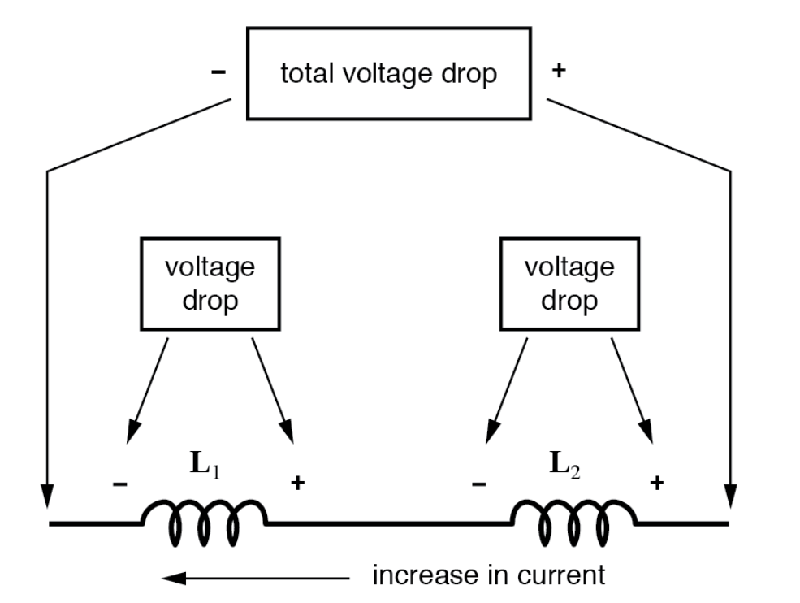
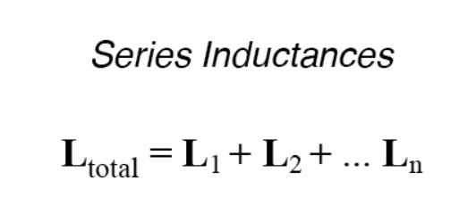
Thus, the total inductance for series inductors is more than any one of the individual inductors’ inductances. The formula for calculating the series total inductance is the same form as for calculating series resistances:

